Slide 1





HOSPITAL PATIENT RECORDS
DASHBOARD
MINIPROJECT 2
SUMBITTED BY:
EZHILARASI K TEAM 1

Slide 2

Project
Objectives
To analyze patient admission trends and identify changes in hospital demand over time.
To evaluate department-wise patient distribution and optimize resource allocation.
To identify the most common diseases and support preventive healthcare planning.
To analyze revenue generated by each department for financial decision-making.
To build an interactive Tableau dashboard with KPIs, filters, and forecasting capabilities.

Slide 3


Data Set
1
COLLECT DATA
Preparation
2
CLEAN DATA
3
ANALYZE DATA
5 Key Steps to Analyze Data
The hospital dataset was cleaned by removing inconsistencies and validating important fields.
New columns such as Admission Date, Department, Doctor Name, Mobile Number, and Aadhar Number were added to enrich the dataset.
Formula-based columns including Age Group, Recovery Days, Revenue Category, and Cost Category were created for advanced analysis.
Data types were standardized to ensure accurate calculations and
4
INTERPRET RESULTS
visualizations in Tableau. The prepared dataset development.
5
VISUALIZE FINDINGS
was imported into Tableau for dashboard

Slide 4




Dashbaord Preparation
INTERACTIVE CHARTS VISUALIZE PATIENT DISTRIBUTION
TABLEAU FORECAST
DEPARTMENT, GENDER, MONTHLY ADMISSIONS, REVENUE, AND DISEASE TRENDS.
Total Patients, Total Revenue, Average Length of Stay, Readmission Rate, and Patient Satisfaction.
KPI CARDS DISPLAY
DYNAMIC FILTERS ALLOW USERS TO EXPLORE DATA
Explore data based on department, gender, doctor, admission type, and date.
used to estimate future patient admission trends for better planning.

Slide 5
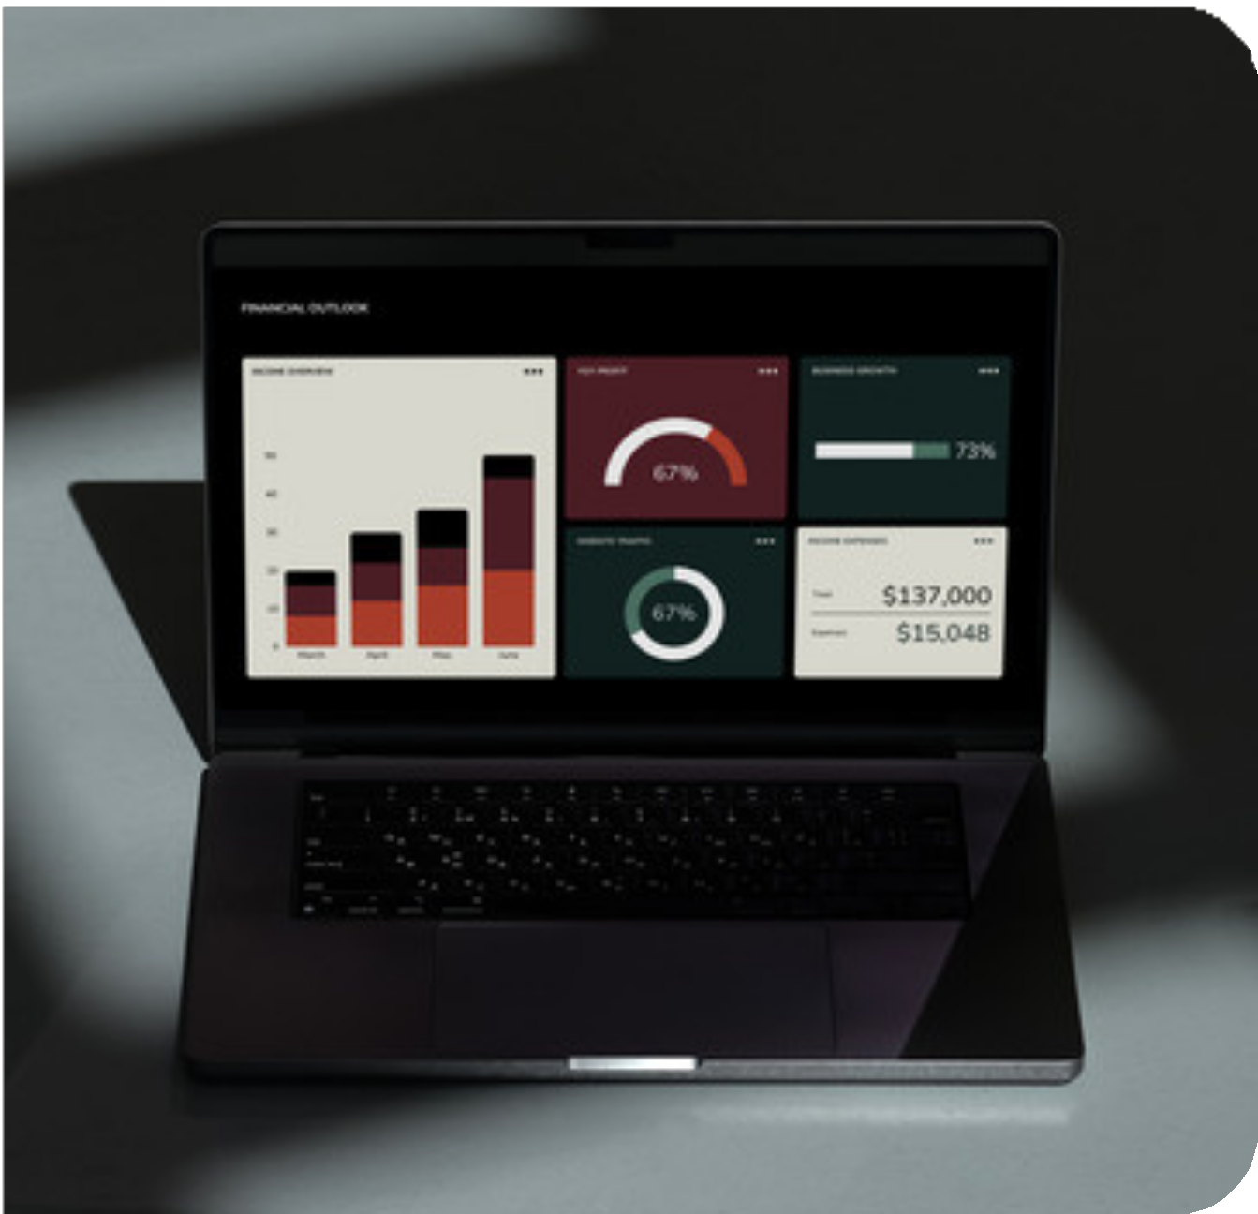
Key Insights
& Business Impact
The dashboard
identifies departments with the highest
patient load, efficiently.
Disease trend
helping management allocate resources
analysis highlights common medical
conditions, enabling preventive healthcare initiatives. Monthly admission analysis supports forecasting and improves hospital capacity planning.
Revenue analysis helps identify high-performing departments and areas requiring operational improvement.
The dashboard enhances decision-making by providing clear, interactive, and actionable healthcare insights.

Slide 6
The Hospital Patient successfully converts visual insights.
Records Analysis patient data into
Dashboard meaningful
Conclusion
The project improves understanding of patient demographics, department performance, and hospital revenue.
Interactive dashboards enable faster analysis and more informed management decisions.
Forecasting features help hospitals prepare for future patient admissions and resource requirements.
Overall, this project demonstrates how Tableau can be
used to support efficient hospital operations and improve patient care.

